Slide 1

Big Data
Workshop

Slide 2
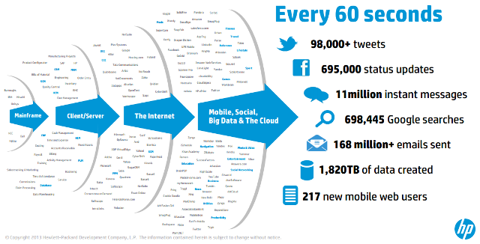
What is BigData...?

Slide 3
Word Count Problem
Deer. Car, Bear, River, Car, Bear,
Car, Deer, Car, Deer, Car, River
Bear - 2
Car - 5
Deer - 3
River - 2
Process

Slide 4
Approach ?
Multi-threaded java program on single JVM
Multiple JVM’s on single Machine
Multiple JVM’s on Multiple Machines

Slide 5
Solution - Cluster Computing Framework !
Distributed File system - HDFS
Resource Management - YARN
Execution Engine - Hadoop MapReduce OR Spark OR Tez
Cluster Monitoring - Ambari
Cluster Coordinator - Zookeeper

Slide 6
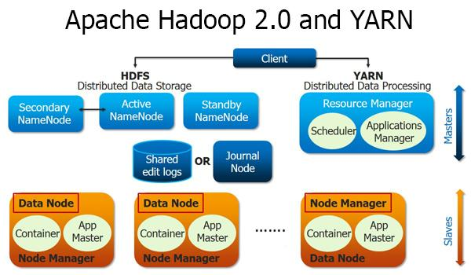

Slide 7
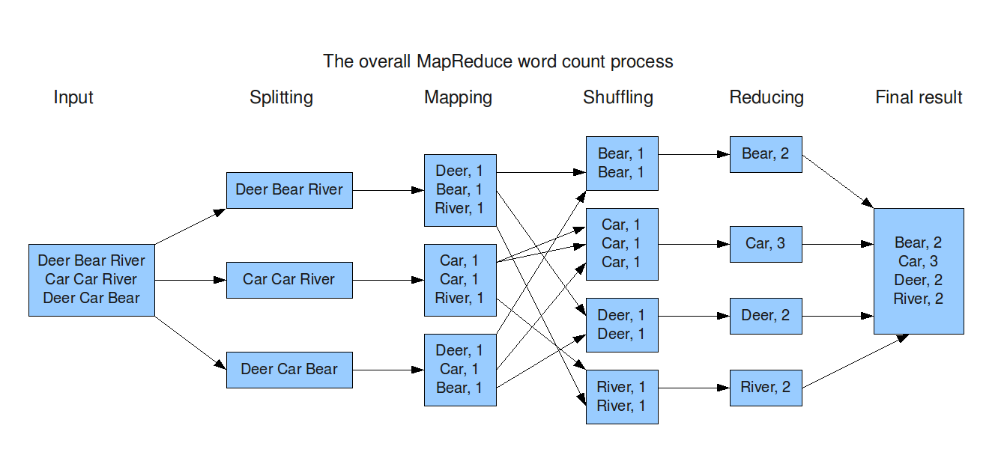
Map & Reduce Phases
Final Key 2 Values
Final Key 3 Values

Slide 8
Time to hack

Slide 9
Break !!

Slide 10
Limitations with Hadoop MR
Only Batch Processing.
Hadoop MR API is not functional.
MR has a bloated computation model.
Has no awareness of surrounding MR pipelines, which can be used for optimization.
Iterative algorithms are difficult to implement.

Slide 11
Spark to the rescue!
Mappers do not write to file system (by default).
Uses Akka for data communication between nodes.
Lazy Computation.
Functional syntax.
Better RDD (Resilient Distributed Dataset) API.
Extension of Spark Streaming for (near) Real-time processing.

Slide 12
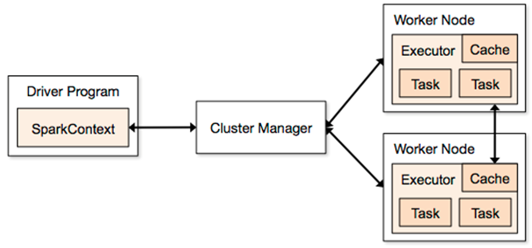
Spark Architecture

Slide 13
Spark in Action!

Slide 14
Thank You!
Questions?

